Slide 1
Citation analysis:
Web of science, scopus
Masoud Mohammadi
Medical Informationist
Golestan University of Medical Sciences

Slide 2
Citation Analysis
Citation analysis is the study of the impact and assumed quality of an article, an author, or an institution based on the number of times works and/or authors have been cited by others
Citation analysis is the examination of the frequency, patterns, and graphs of citations in documents. It uses the pattern of citations, links from one document to another document, to reveal properties of the documents. A typical aim would be to identify the most important documents in a collection. A classic example is that of the citations between academic articles and books.[1][2] The judgements produced by judges of law to support their decisions refer back to judgements made in earlier cases so citation analysis in a legal context is important. Another example is provided by patents which contain prior art, citation earlier patents relevant to the current claim.

Slide 3
Citation Databases
Citation databases are databases that have been developed for evaluating publications. The citation databases enable you to count citations and check, for example, which articles or journals are the most cited ones
In a citation database you get information about who has cited an article and how many times an author has been cited. You can also list all articles citing the same source.
Most important citation database are
“Web of Science”,
“Scopus”
“Google Scholar”

Slide 4
Web of Sciences
Web of Science is owned and produced by Thomson Reuters. WoS is composed of three databases containing citations from international scientific journals:
  Arts & Humanities Citation Index - AHCI
  Social Sciences Citation Index - SSCI
  Science Citation Index - SCI
Journal Coverage:
  Aims to include the best journals of all fields. Included journals are for example: European Journal of Marketing, Journal of Finance, Strategic Management Journal
Citation Coverage:
  Includes citations starting from the year 1945
  Citations can be counted in a simple or complex manner, with different results
  The Citation Report is easy to generate, but only counts references to articles that are also in the database.
  Searching based on authors by using Cited Reference Search is more cumbersome, but will also return references to items outside of the database, including articles, conference proceedings, books, reports etc.

Slide 5
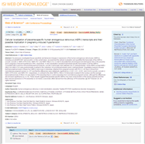
Web of Science – What is a citation?
2004
2008
Times Cited
2003
2000
2009
Cited References
2000
Related Records
1974
1998
2008
1993
1999
2002
2000

Slide 6

Metrics
Science Citation Index
Expanded
Social Sciences and Arts&Humanities Citation Index
Journal-level data
Researcher-level data
Institution-level data
Country/region-level data
Field/discipline-level data
Article-level data

Slide 7
Journal Citation Reports®
The Journal Citation Reports module within InCites allows you to evaluate and compare journals using citation data drawn from approximately 12,000 scholarly and technical journals and conference proceedings from more than 3,300 publishers in over 60 countries. Journal Citation Reports is the only source of citation data on journals, and includes virtually all specialties in the areas of science, technology, and social sciences.
JCR provides dynamic, interactive features supported by visualizations of JCR indicators that allow researchers and librarians, as well as publishers, to compare, evaluate and inform their decisions on published research in varying fields.

Slide 8
Key features in the Journal Citation Reports allow you to:
  Focus on desired subject categories, enabling you to review journal titles and key performance indicators in the category;
  Compare multiple journals based on a chosen indicator;
  Evaluate the performance of journals in which you or your organization has published research;
  Recognize trending journals in key research categories;
  Identify the ideal journal in which to publish your forthcoming research;

Slide 9
Journal Information Provided by JCR
Total Cites
Impact Factor
5-Year Impact Factor
Immediacy Index
Cited Half-Life
Citing Half-Life
Eigenfactor Score
Article Influence

Slide 10
Below is only a simplified explanation of the metrics. For definitions and details, click the help in the JCR journal report pages
Total Cites | Total number of citations for this journal in the JCR year
Impact Factor | On average, how many times an article in this journal is being cited – based on articles published in the two previous years
5-Year Impact Factor | On average, how many times an article in this journal is being cited – based on articles published in the five previous years
Immediacy Index | On average, how many times an article in this journal is being cited in the same year – based on last year's data (reflects more about the nature of the subject than journal quality)
Cited Half-Life | Indicates how far back the older articles in this journal are still being cited (reflects more about the nature of the subject than journal quality)

Slide 11
Below is only a simplified explanation of the metrics. For definitions and details, click the help in the JCR journal report pages
Citing Half-Life | Indicates how recent or how old the bibliography referred by articles in this journal are (reflects more about the nature of the subject than journal quality)
Eigenfactor Score | The Eigenfactor Score is some kinds of enhanced 5-year impact factor – by giving higher score for getting cited in more influential journals and eliminates self-citation
Article Influence Score | The Article Influence Score is derived from the Eigenfactor Score based on matching the share of the journal's influence against the share of the journal's share of articles. The neutral influence score is 1.00 – thus a journal with article influence score greater than 1.00 indicates that each article in the journal has above-average influence and vice versa

Slide 12
Quartile Comparison (Q)
Quartile Comparisons enable users to compare various quartile ranks from metrics for chosen journals within a given subject category. Users can see how each journal ranks within a given quartile, compared with other journals of their choosing, so long as each is categorized within the same subject. The ability to select multiple quartile metrics simultaneously allows for a comprehensive view of how each journal ranks within metrics for a given year.

Slide 13
The following example surveys three journals categorized within Food Science & Technology and quartile rankings for each of the available metrics.
Journal | JIF Quartile | JIF-JSC Quartile | 5 Year IF Quartile | Immediacy Index Quaritle | Eigenfactor Quartile | Article Influence Score
Critical Reviews in Food Science and Nutrition | Q1 | Q1 | Q1 | Q1 | Q1 | Q1
Food Biotechnology | Q4 | Q4 | Q3 | Q4 | Q4 | Q3
Food Chemistry | Q1 | Q1 | Q1 | Q1 | Q1 | Q1

Slide 14
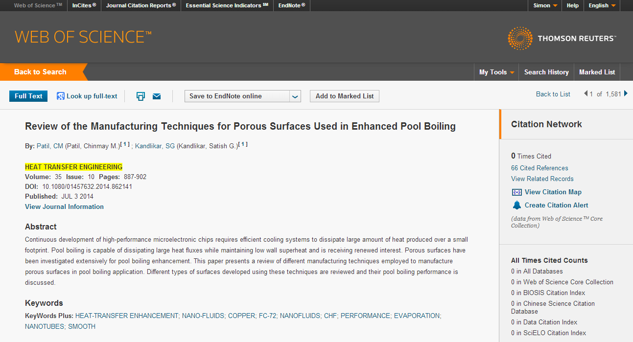
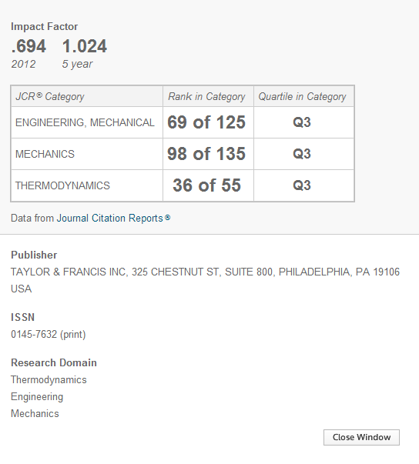
JOURNAL CITATION REPORT
Access Journal Citation Reports from anywhere
View summary journal information within the Web of Science interface

Slide 15
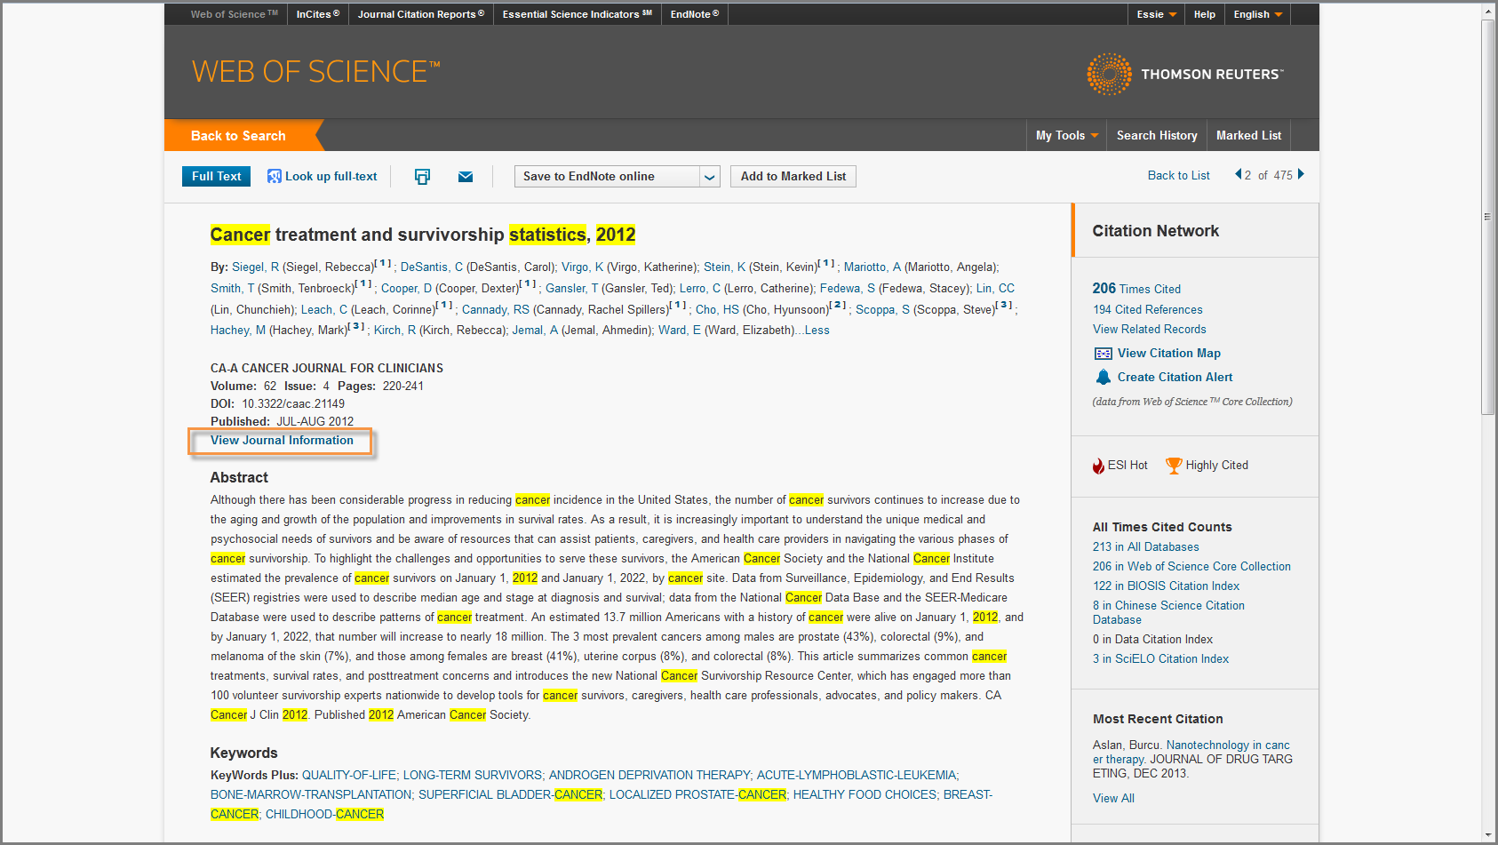
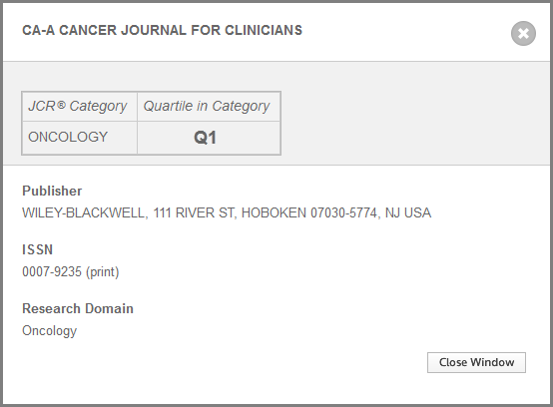
JOURNAL CITATION REPORTS

Slide 16
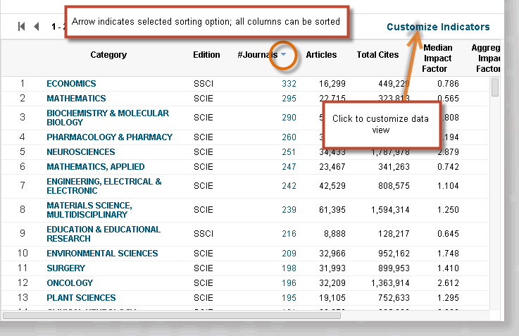
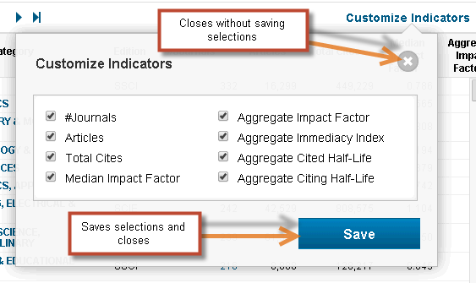
JOURNAL CITATION REPORTS
CATEGORIES BY RANK
The data grid will always be the area that displays user's choices. The default view is the categories, ranked by number of journals (to correspond to the default visualization). This list can be sorted or customized. For users signed in with UNP, these selections are preserved from session to session.

Slide 17
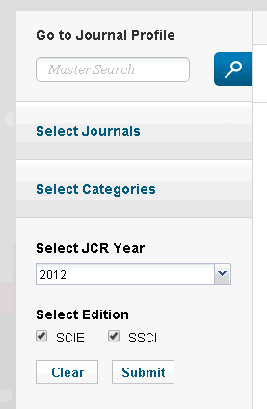
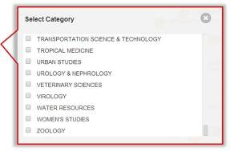
JOURNAL CITATION REPORTS
CATEGORIES BY RANK – filtering options
On Categories by Rank, this is the left navigation bar:
"Go to Journal Profile" is a master search tool.
"Select Journals" and "Select Categories" allow the user to filter the data grid based on journal title or category name. Please note that in the Categories by Rank section, the resulting data grid will contain category-level data and the visualization will also display at the category level.
"Select JCR Year" allows users to choose the year of the category-level data they wish to view.
"Select Edition" allows users to choose which edition, Science Citation Index-Expanded or Social Science Citation Index, they wish to browse.
Clicking "Clear" will restore the default view; clicking "Submit" will submit the selections and refresh the data grid.

Slide 18
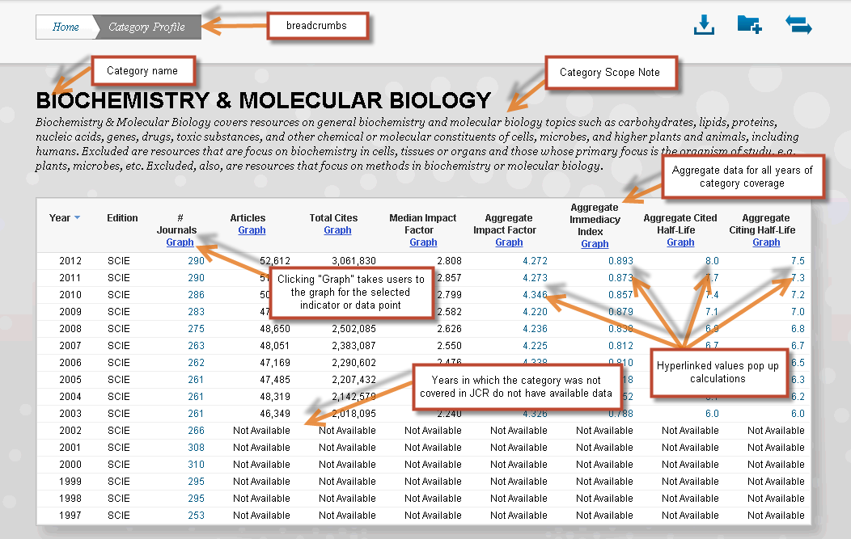
JOURNAL CITATION REPORTS
CATEGORIES BY RANK
Clicking any hyperlinked value will pop up a window displaying the calculations behind that value. Clicking on "Graph" in any column will bring up a graph of the relevant indicator or data point in the space below the table.

Slide 19
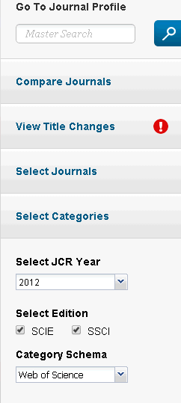
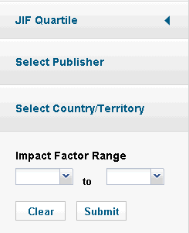
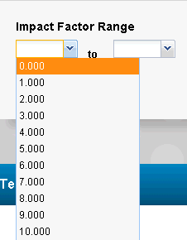
JOURNAL CITATION REPORTS
JOURNAL BY RANK – filtering
Many filtering options (Journal Profile, Journals, Categories, JCR Year, & Edition) are the same as on the Categories by Rank page.
“Compare Journals” will take users to the Compare Journals component.
“View Title Changes” shows the title changes for the selected JCR Year.
“Select Category Scheme” allows users to view ranked lists of journal using either the WOS or ESI category scheme.
“JIF Quartile” allows users to choose which quartile’s journals to view
“Select Publisher” and “Select Country/Territory” allow users to filter based on publisher or country of origin.
“Impact Factor Range” allows users to choose their preferred range of Impact Factor via a drop-down list.

Slide 20
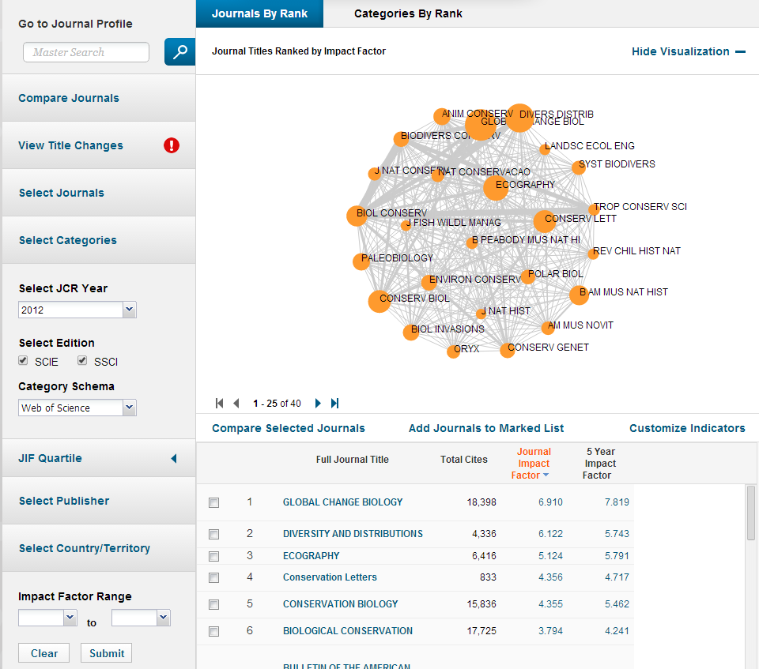
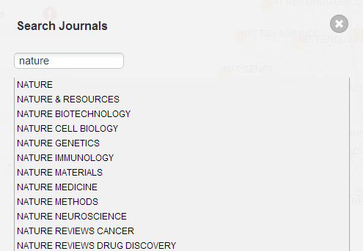
JOURNAL CITATION REPORTS
JOURNAL BY RANK – filtering
Search for specific journals to create a custom list.
Auto-completes any title you type in

Slide 21
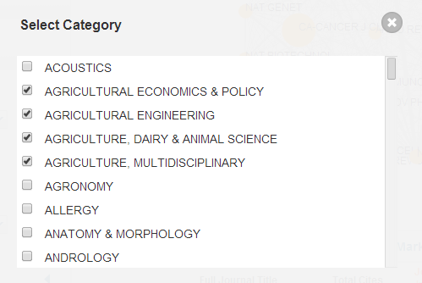
JOURNAL CITATION REPORTS
JOURNAL BY RANK – filtering
Select a subject category or categories to see all journals

Slide 22
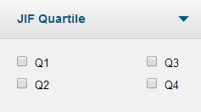
JOURNAL CITATION REPORTS
JOURNAL BY RANK – filtering
Limit your analysis to only those journals in certain quartiles of their subject area
Or limit to a specific range of Impact Factors

Slide 23
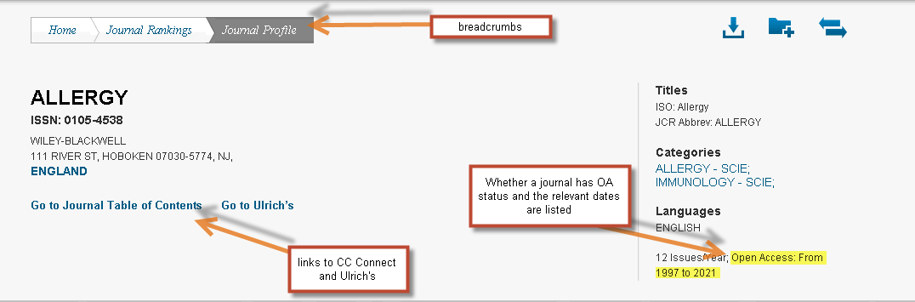
JOURNAL CITATION REPORTS
JOURNAL BY RANK – journal profile page
The top of the Journal Profile Page contains the name of the journal, publishing information, title information, category listings (hovering over the category name will pop up Scope Notes for that category), languages, publication frequency, and whether or not that journal is an Open Access (OA) title. Links to Current Contents Connect and Ulrich's also appear in this section.

Slide 24
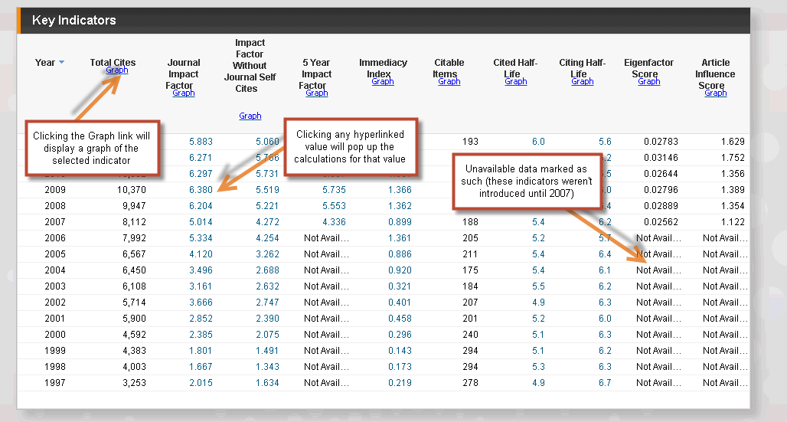
JOURNAL CITATION REPORTS
JOURNAL BY RANK – key indicators
Directly below the journal information is a table containing all of the key indicators for that journal. This table contains data for all the years of coverage. For years the journal was not covered or was suppressed, data columns are marked as "Not Available." Also, data columns may indicate "Not Available" if the particular indicator had not yet been included in JCR.

Slide 25
Analysis Tools
Analyze Results
extract citation data from a selected field (e.g. source title, country, author), and produces a report showing the values in ranked order
Create Citation Report
view aggregate citation statistics for a set of search results
e.g. breakdown of citations over years, average citations per year

Slide 26
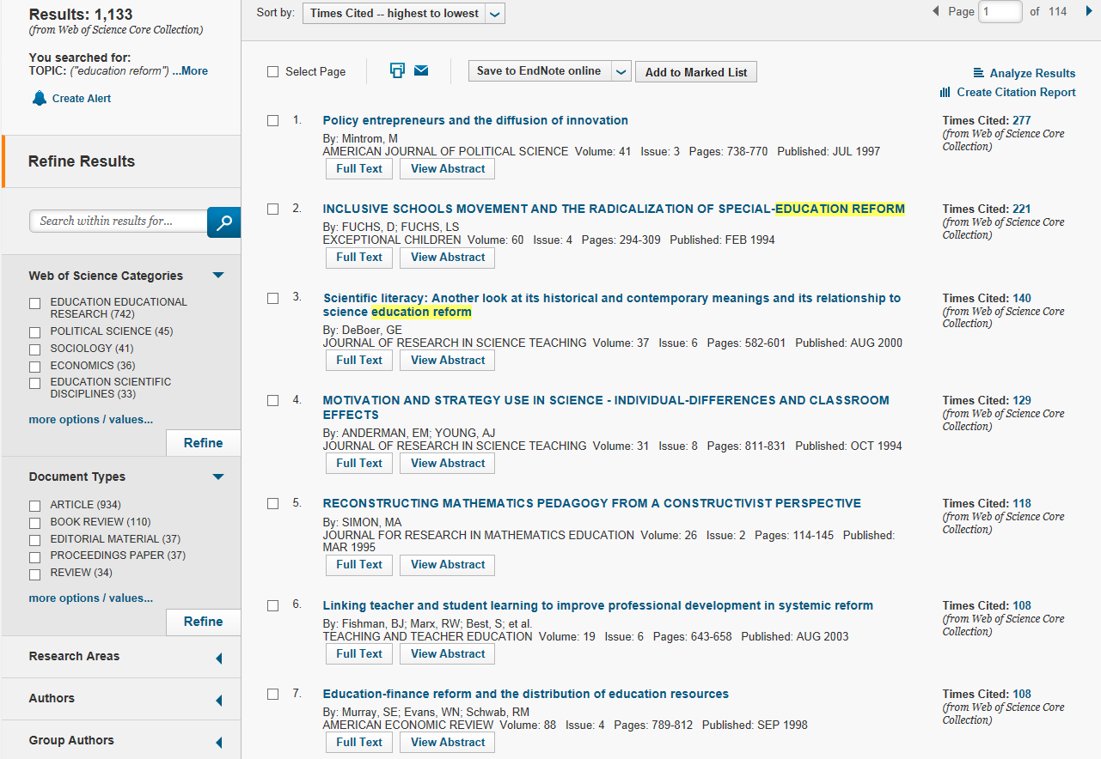
Analysis Tools
Analysis tools

Slide 27
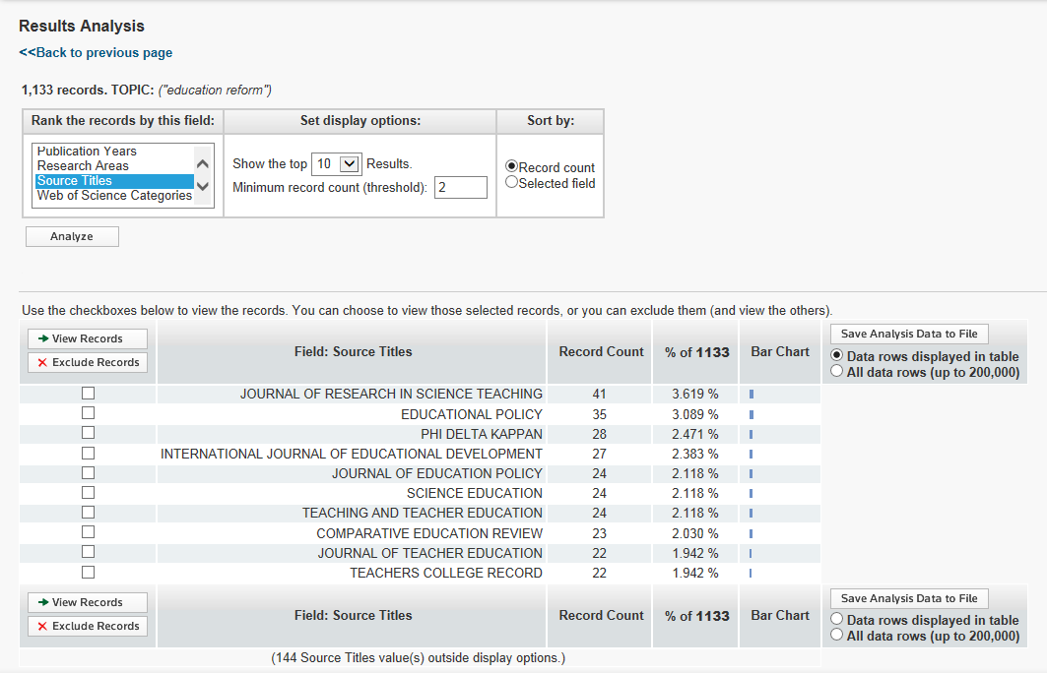
1. Analyze Results
Max number of items to display:
top 500 results
You can rank the search results with different field options, e.g. source titles
e.g. Rank the journals by number of articles on this topic

Slide 28
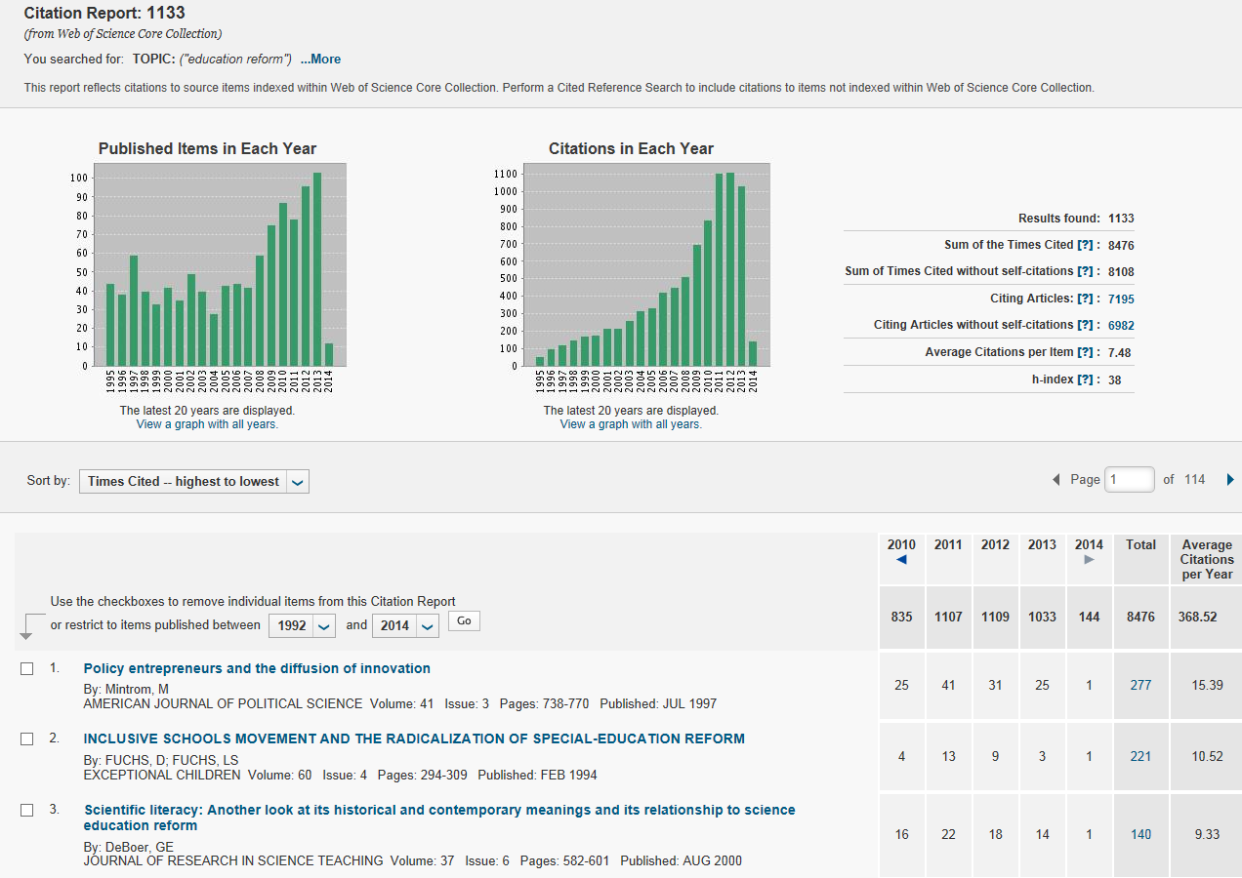
2. Create Citation Report
Citation statistics of records found
Most highly cited article

Slide 29
Scopus
Scopus is owned and produced by Elsevier.
Journal Coverage:
  Indexes more journals than Web of Science, including some conference proceedings, which results in better coverage for Economics and IT. Includes journals such as International Journal of Entrepreneurship and Innovation Management, Human Resource Management Journal, Journal of Economics and Business, Journal of International Financial Markets, Institutions and Moey.
Citation Coverage:
  Only indexes citations starting from 1996
  Only counts references to publications that are also in the database
  Use Citation Tracker to generate analyses on up to 5000 publications
  Citations per year and per publication (with or without self-citations), h-index

Slide 30
SCImago
The SCImago Journal & Country Rank is a publicly available portal that includes the journals and country scientific indicators developed from the information contained in the Scopus® database (Elsevier B.V.). These indicators can be used to assess and analyze scientific domains. Journals can be compared or analysed separately. Country rankings may also be compared or analysed separately. Journals can be grouped by subject area (27 major thematic areas), subject category (313 specific subject categories) or by country. Citation data is drawn from over 21,500 titles from more than 5,000 international publishers and country performance metrics from 239 countries worldwide. The SJCR allows you also to embed significative journal metrics into your web as a clickable image widget

Slide 31
Scopus Metrics
CiteScore
Snip
SJR
…

Slide 32
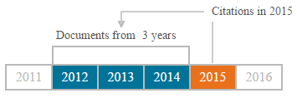
CiteScore
Calculating CiteScore is simple and is based on the average citations received per document. CiteScore is the number of citations received by a journal in one year to documents published in the three previous years, divided by the number of documents indexed in Scopus published in those same three years.

Slide 33
SJR (SCImago Journal Rank)
SJR is weighted by the prestige of a journal. Subject field, quality, and reputation of the journal have a direct effect on the value of a citation.
SJR assigns relative scores to all of the sources in a citation network. Its methodology is inspired by the Google PageRank algorithm, in that not all citations are equal. A source transfers its own 'prestige', or status, to another source through the act of citing it. A citation from a source with a relatively high SJR is worth more than a citation from a source with a lower SJR.

Slide 34
SNIP (Source Normalized Impact per Paper)
SNIP measures a source’s contextual citation impact by weighting citations based on the total number of citations in a subject field. It helps you make a direct comparison of sources in different subject fields.
SNIP takes into account characteristics of the source's subject field, which is the set of documents citing that source. SNIP especially considers
  the frequency at which authors cite other papers in their reference lists
  the speed at which citation impact matures
  the extent to which the database used in the assessment covers the field’s literature
SNIP is the ratio of a source's average citation count per paper and the citation potential of its subject field.

Slide 35
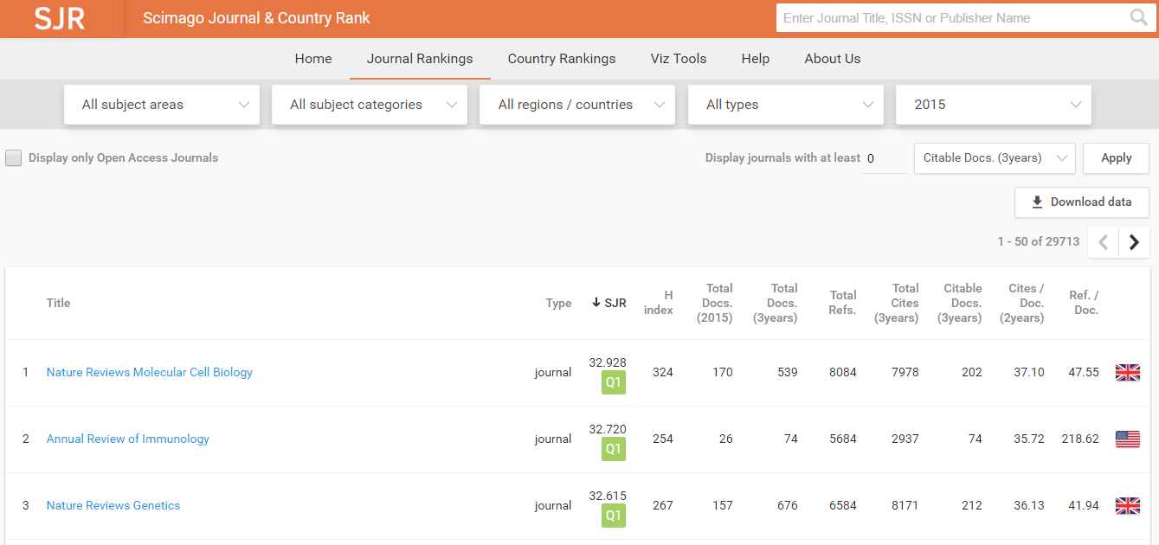
Journal Rank

Slide 36
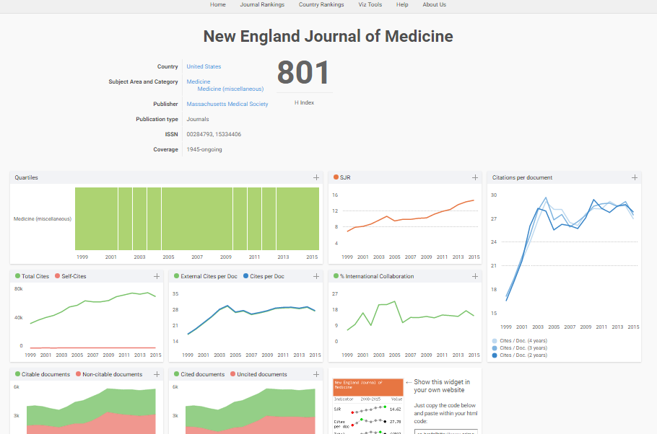

Slide 37
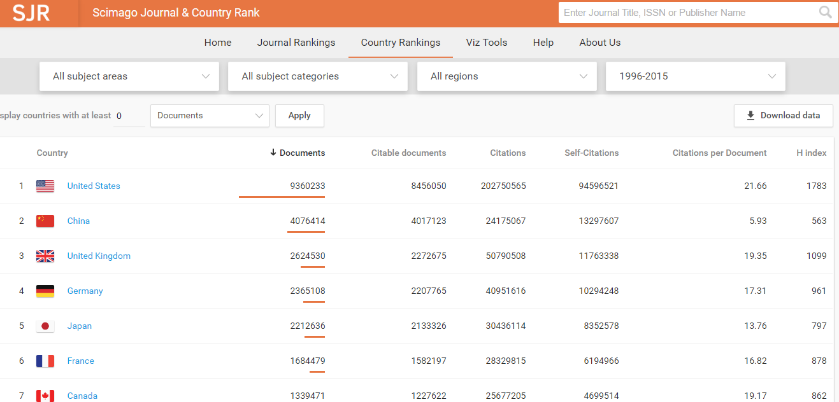
Country Rank

Slide 38
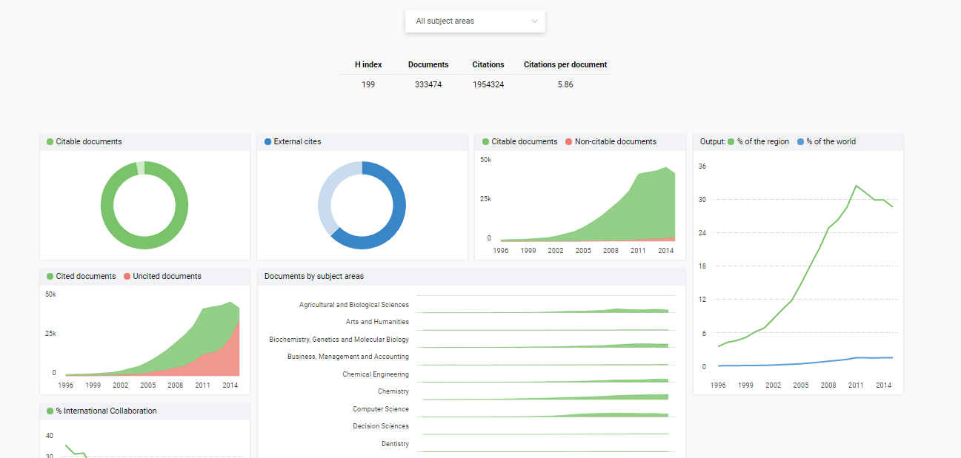

Slide 39
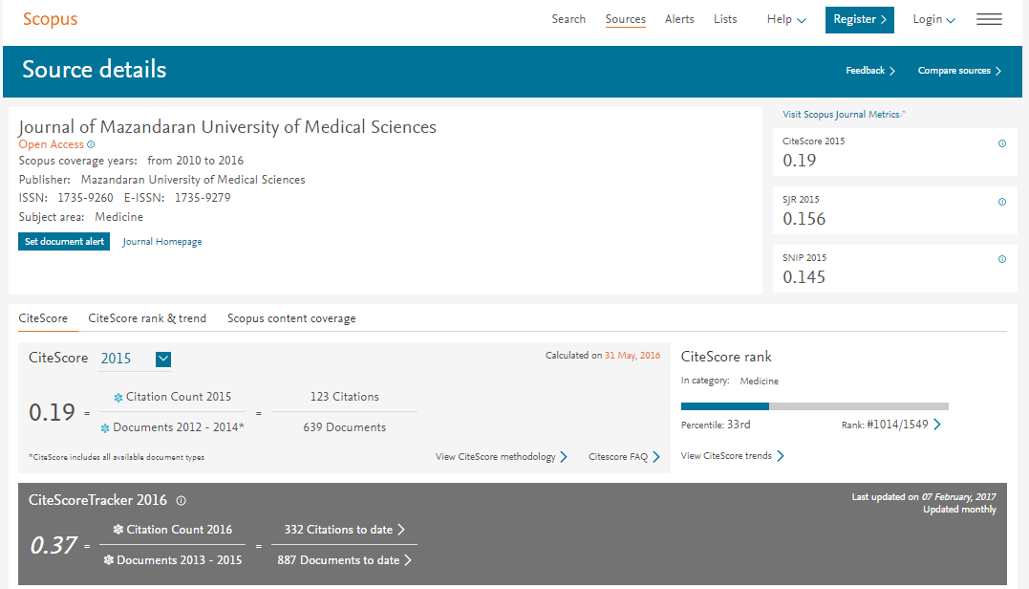

Slide 40
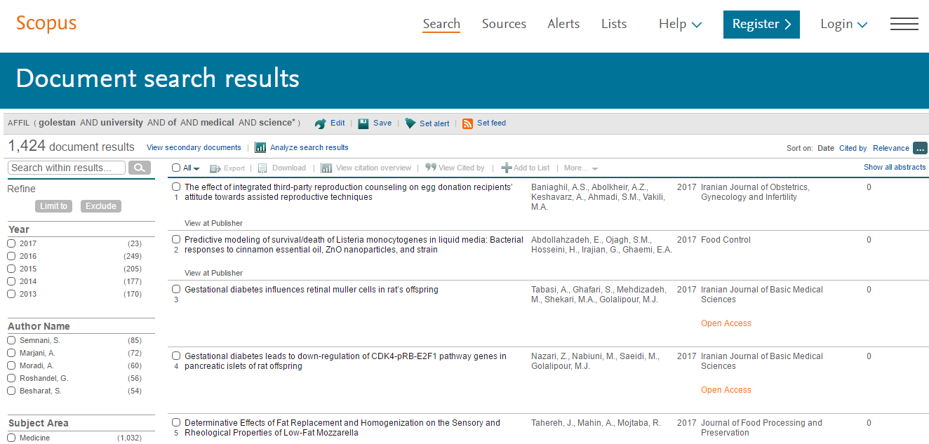

Slide 41
